Slide 1
Mathematical Modeling of Tumor and Cancer Stem Cells
Treated with CAR-T Therapy and Inhibition of TGF- β
Mika Campbell: mikacampbell@spelman.edu
Ciera Sherrill: cierasherrill@spelman.edu 12/7/2022

Slide 2
Paper
Recap
The cost of cancer treatments continues to increase over the years as scientists try to provide a solution to all variations of cancer.
Information about cancer stem cells and their contribution to recurring cancer issues must be taken into account to eliminate the problem. This paper focuses on the difference between the effectiveness of targeting tumor and stem cells with different CAR- T cell therapy.

Slide 3
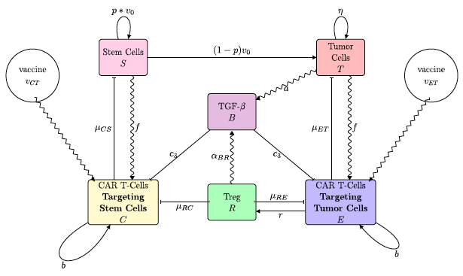
MODEL
where:
T : tumor cell population
S : cancer stem cell population
E : CAR- T Cells that target the tumor
C : Car-T Cells that target the stem cells
v0 : frequency that stem cells divide
p : probability that a stem cell is produced from that division
b : proliferation rate
B: Transforming Growth factor
R: regulatory T-Cells

Slide 4
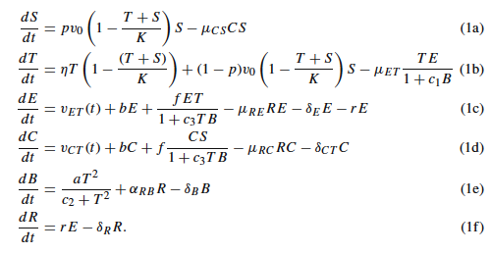
ODE
S= growth of cancer stem cells
T= growth of tumor
E= tumor cells targeted by CAR-T cells
C= cancer stem cells targeted by CAR-T cells
B= TGF-β regulation
R= T-Cells regulation

Slide 5
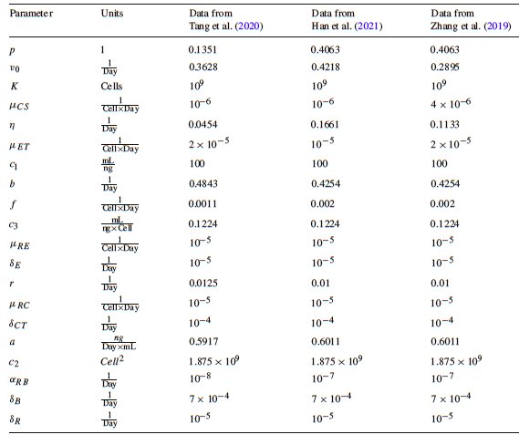
Parameters

Slide 6
PROJECT MOTIVATIONS
A small group of malignant, cancer stem cells is hypothesized to initiate tumor development, promote tumor growth and be the cause of metastasis
Chimeric antigen receptor (CAR) T-cell therapy is a form of immunotherapy where immune cells are genetically modified to fight the tumor cells
TGF - β inhibits CAR - T cells and promotes tumor growth
Traditional treatments, such as chemotherapy and radiation, primarily target the tumor cells leaving the stem cells to potentially cause a recurrence.
This project aims to examine combinations of CAR-T cell treatment targeting both non-stem and stem cancer cells and a treatment that reduces the effectiveness of TGF-β to determine the scenarios that eliminate the tumor.

Slide 7
RESULTS

Slide 8
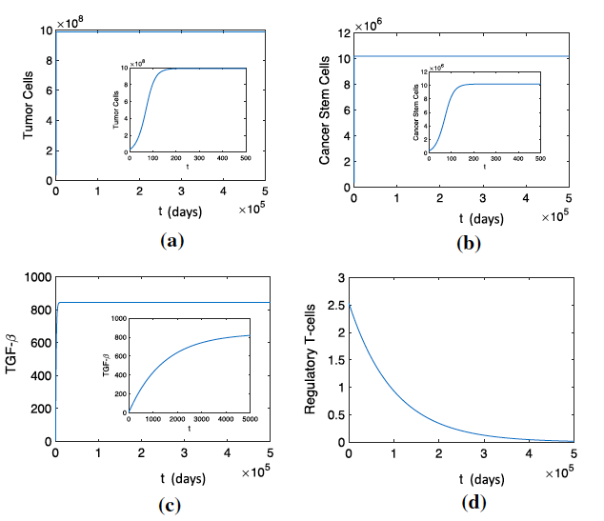
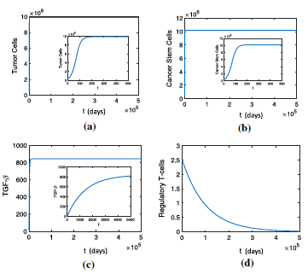
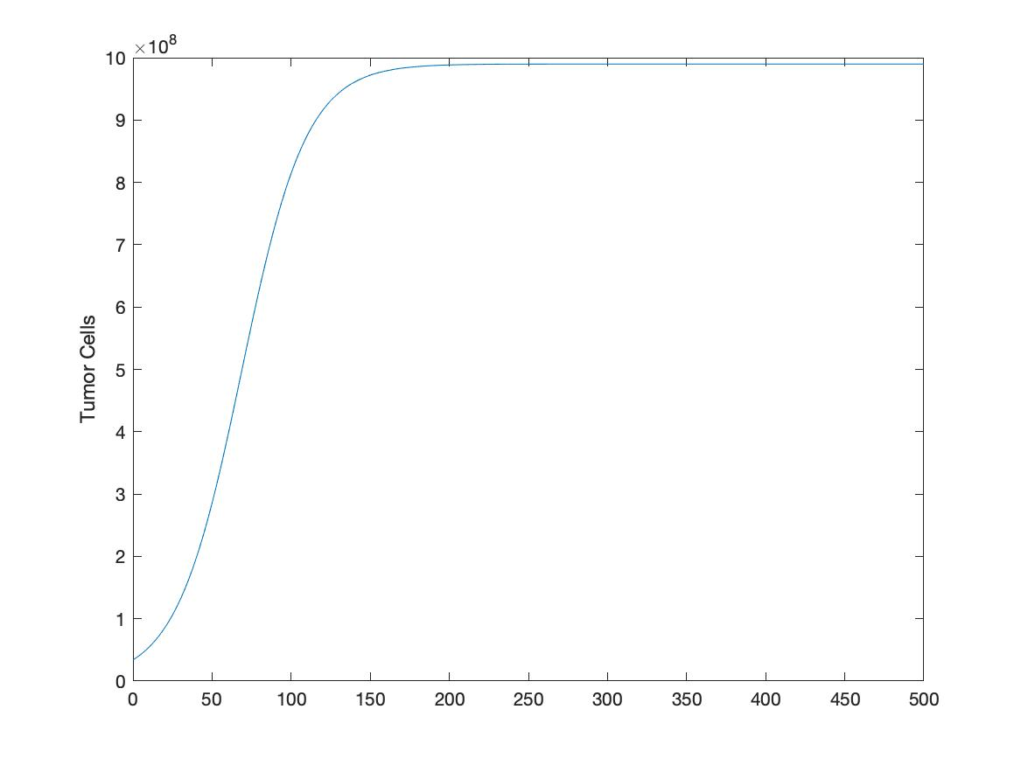
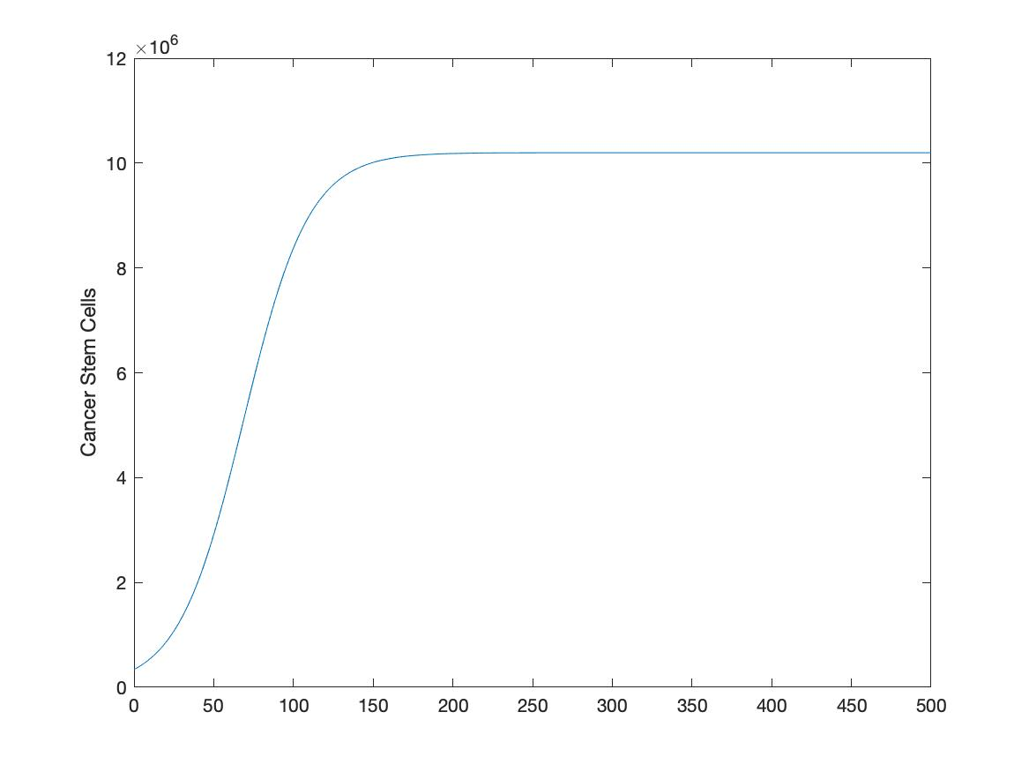
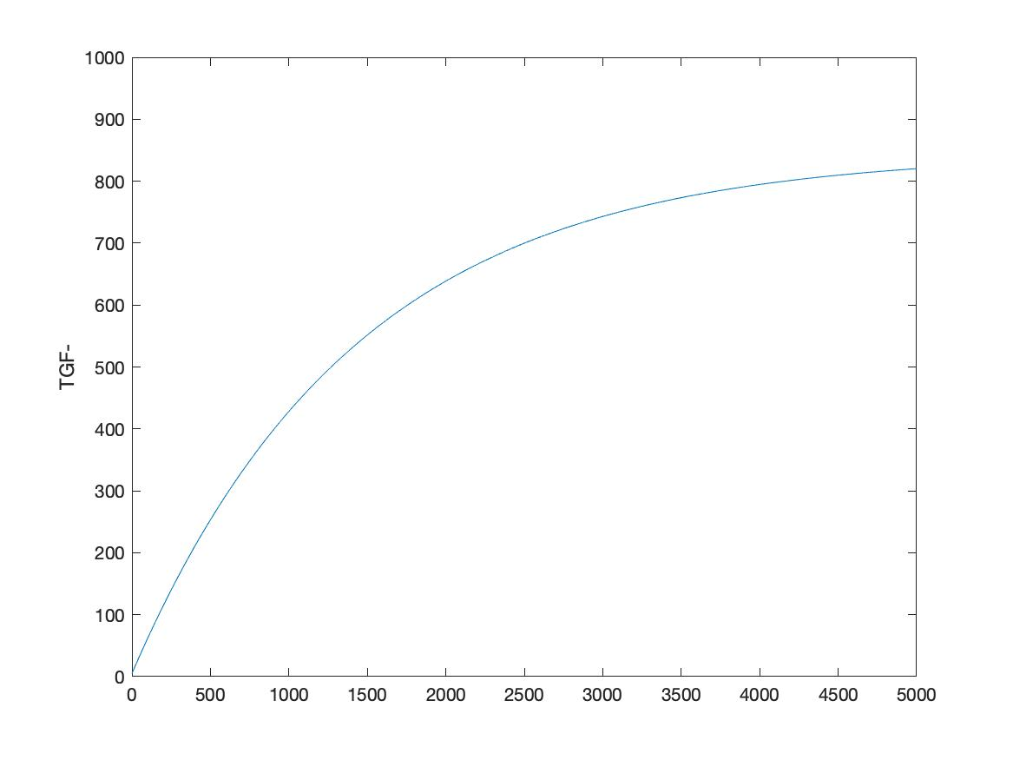
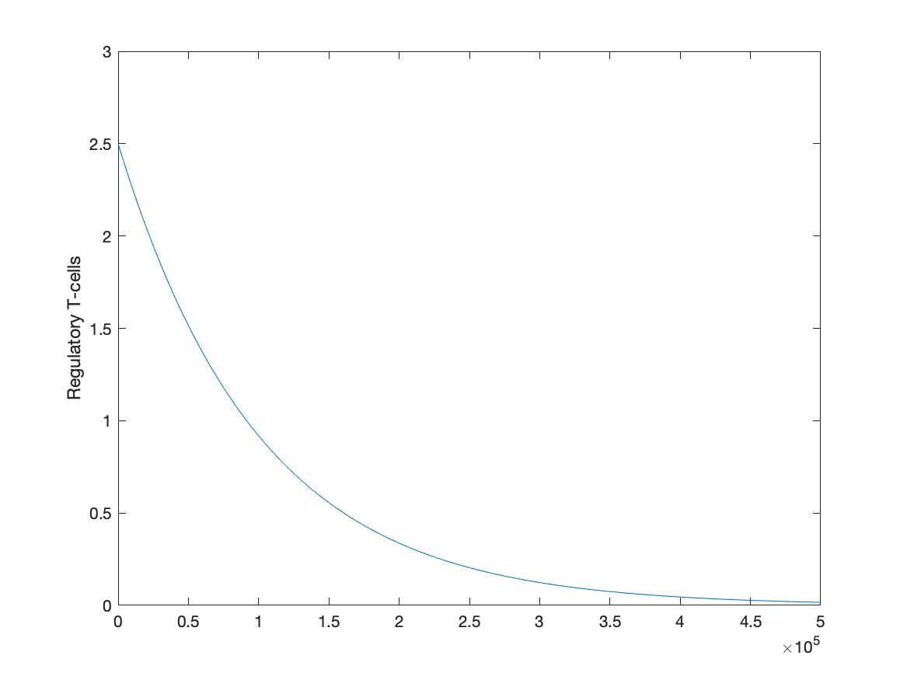
Figure 3
Paper
Results

Slide 9
β
Figure 3

Slide 10
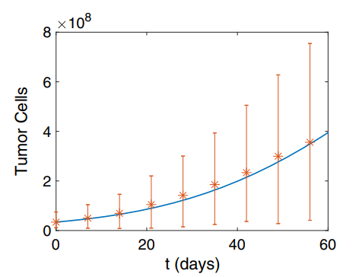
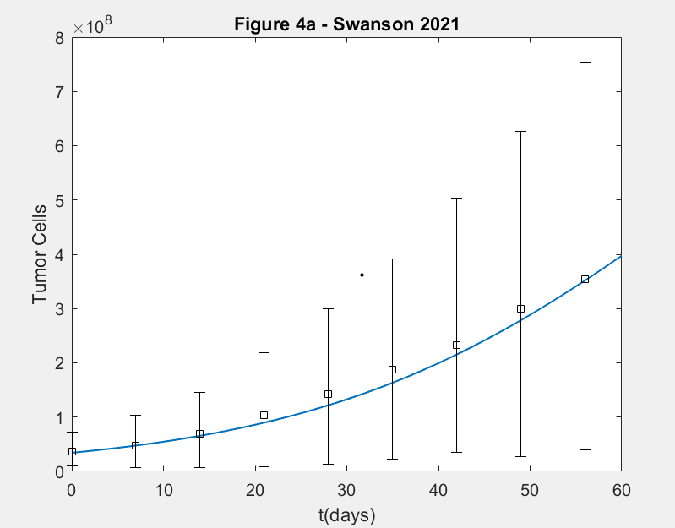
Figure 4a
Paper
Results

Slide 11
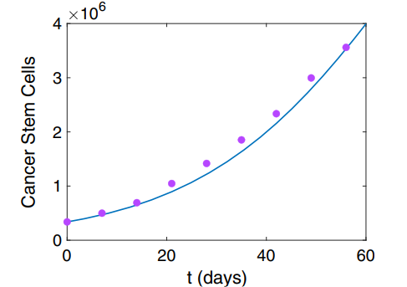
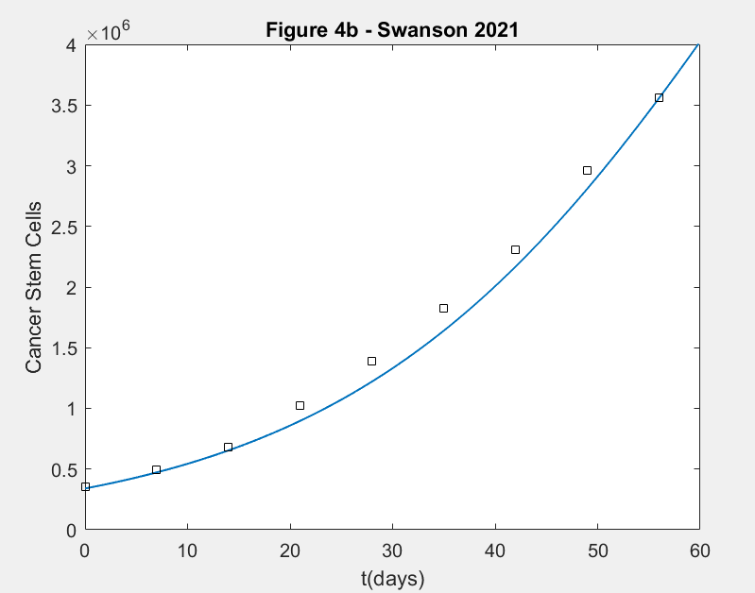
Figure 4b
Paper
Results

Slide 12
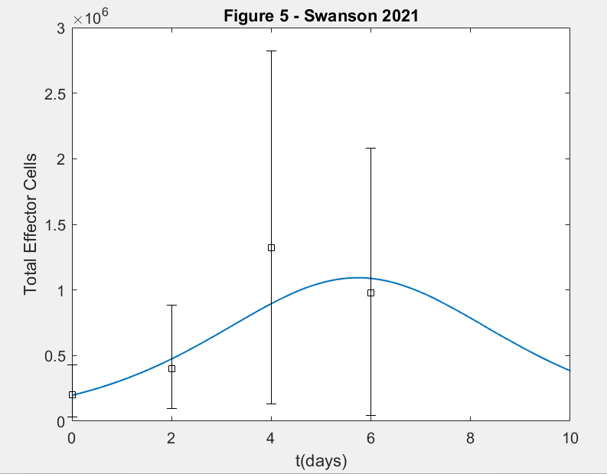
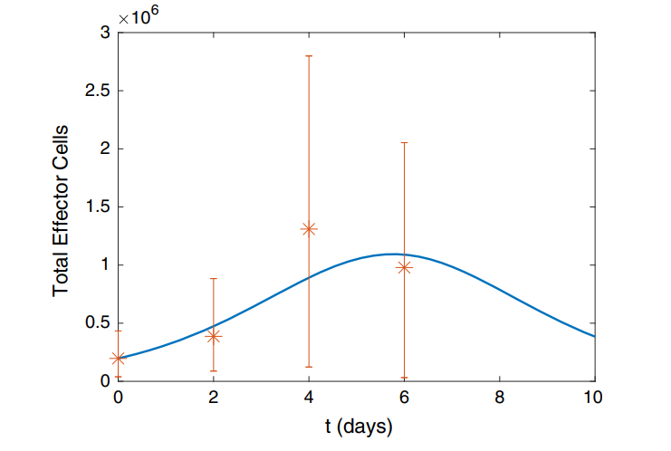
Figure 5
Paper
Results

Slide 13
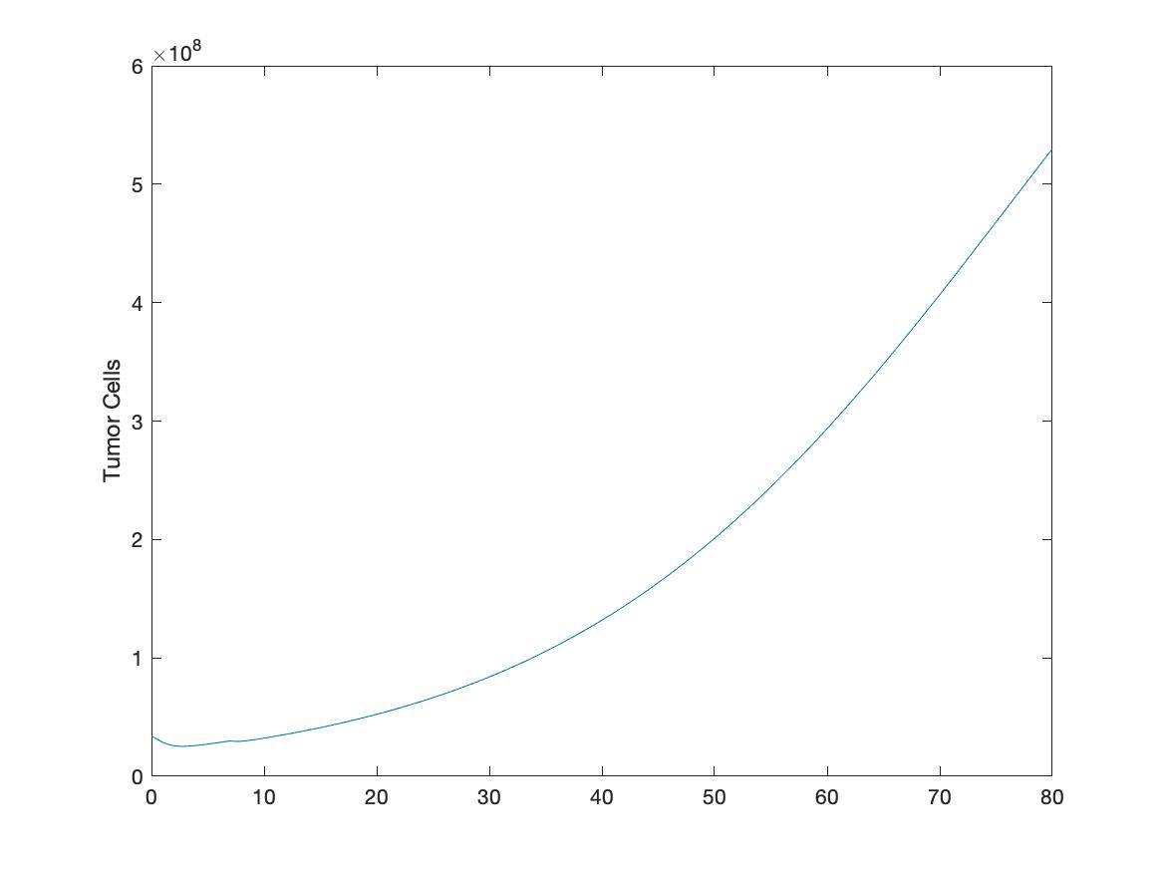
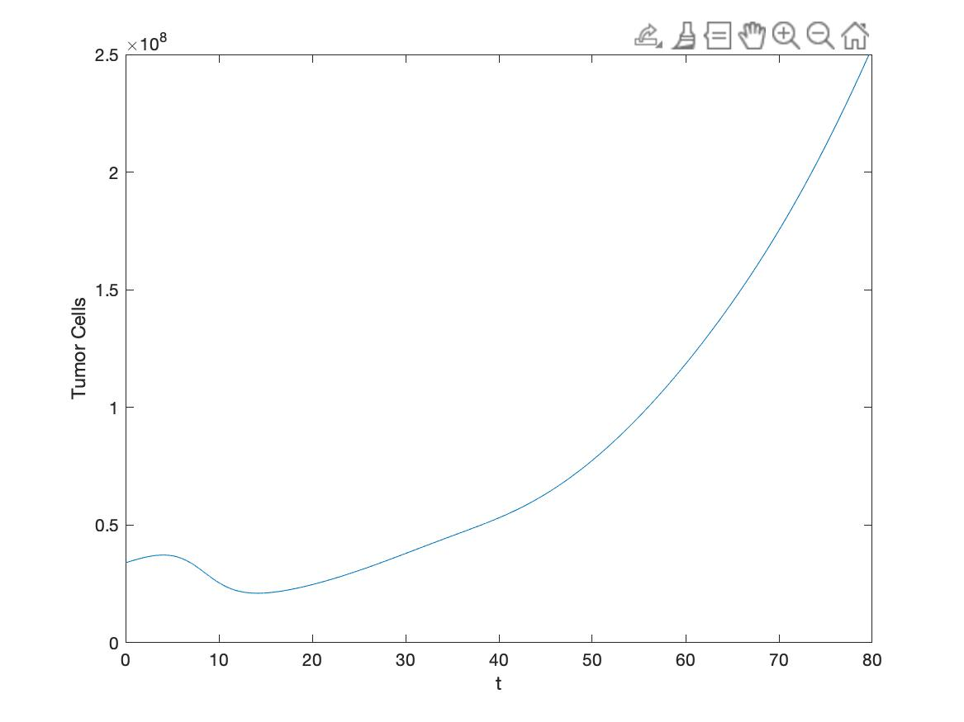
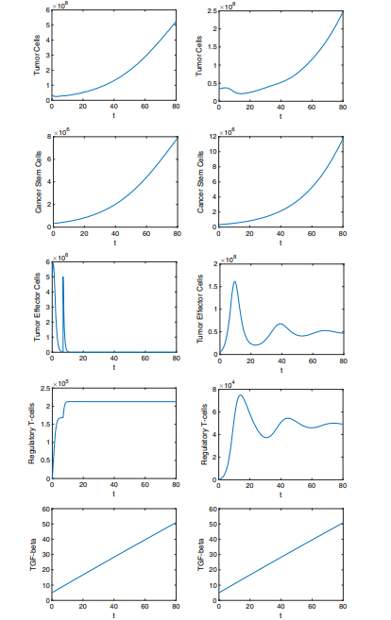
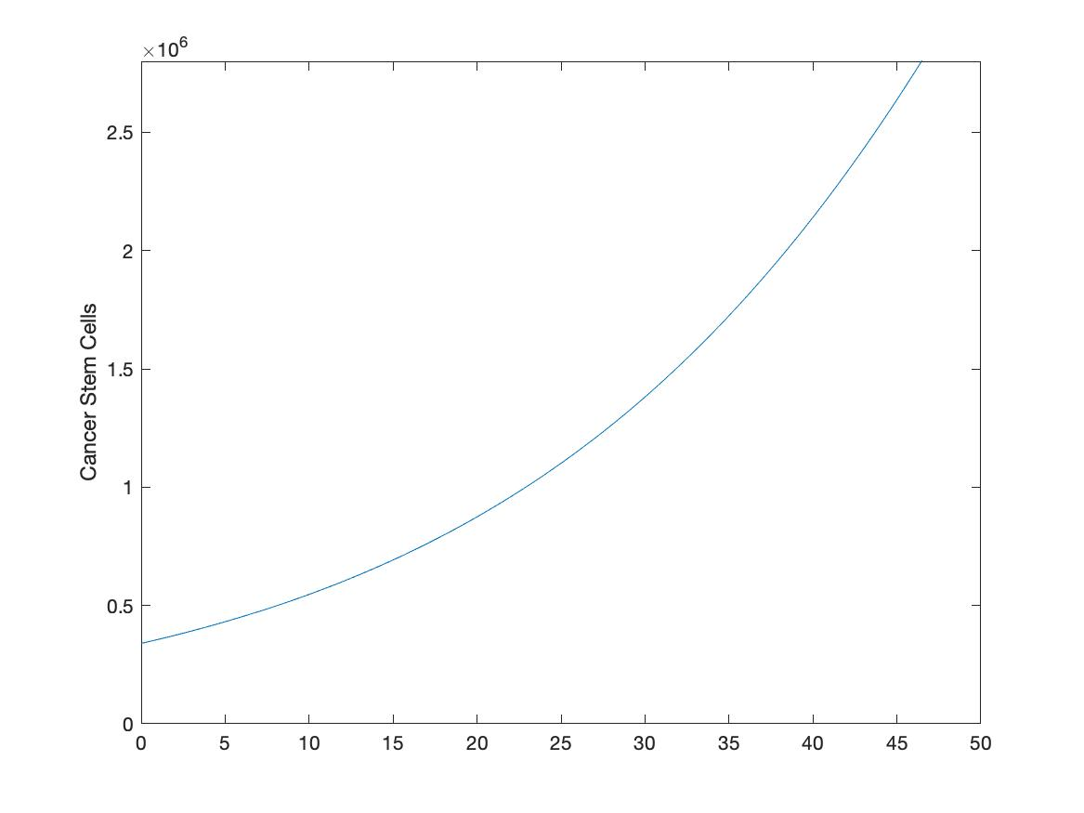
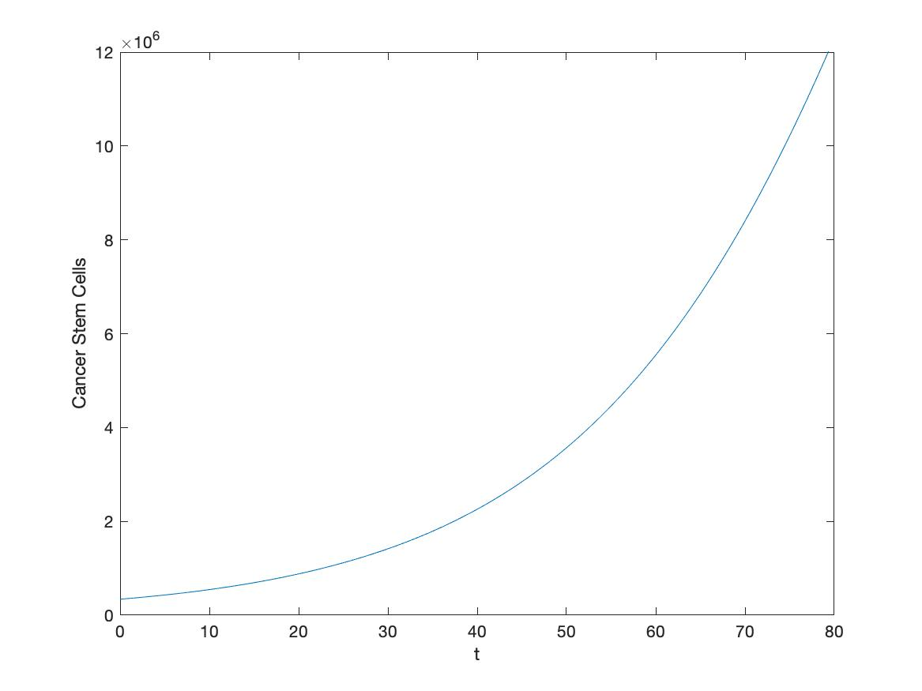
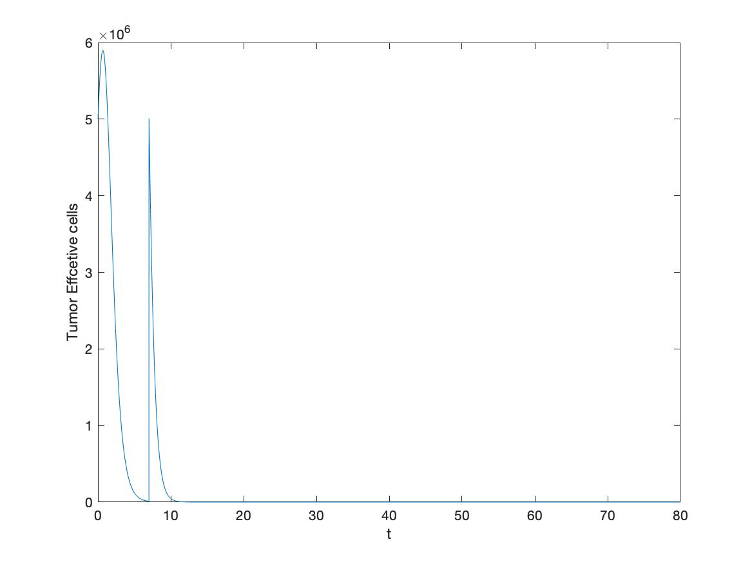
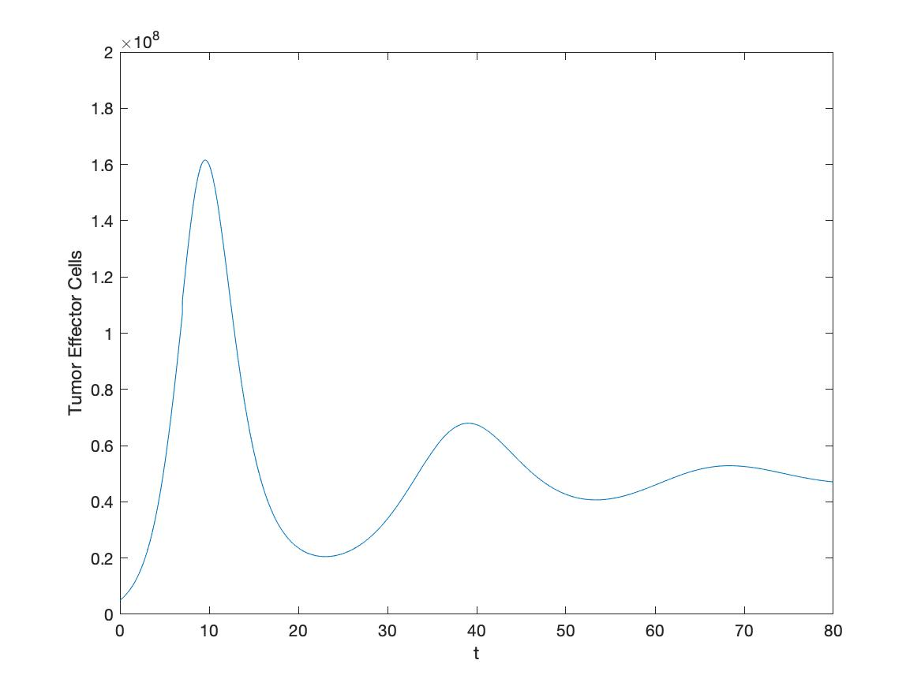
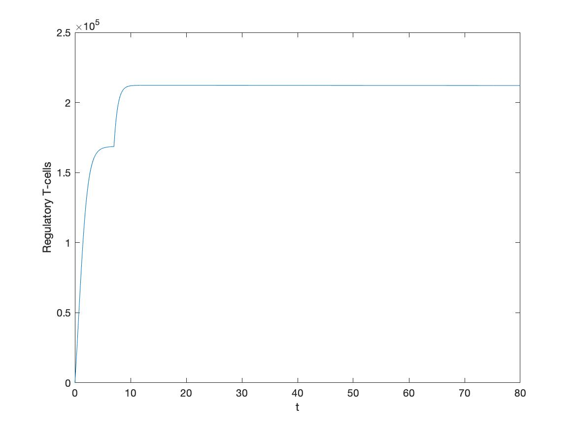
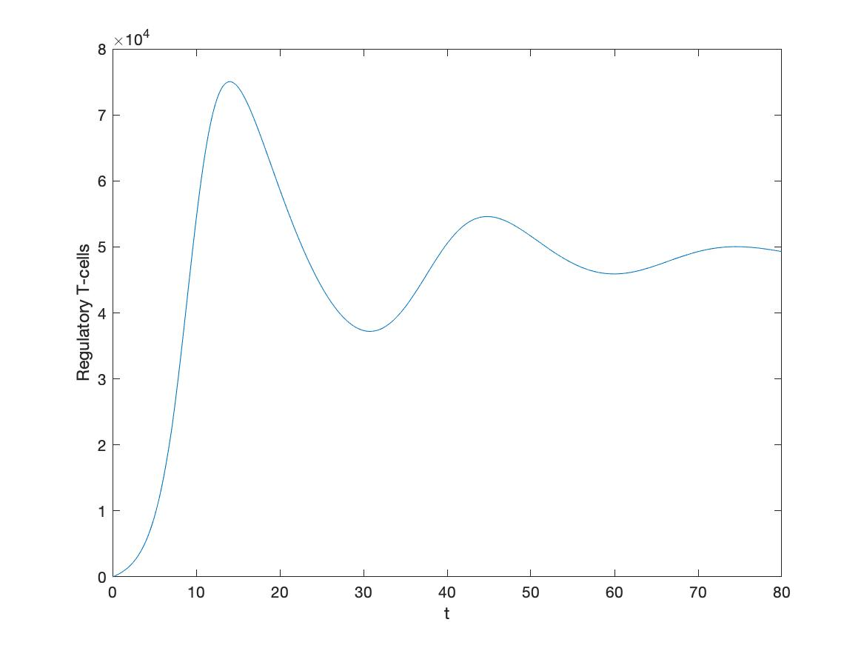
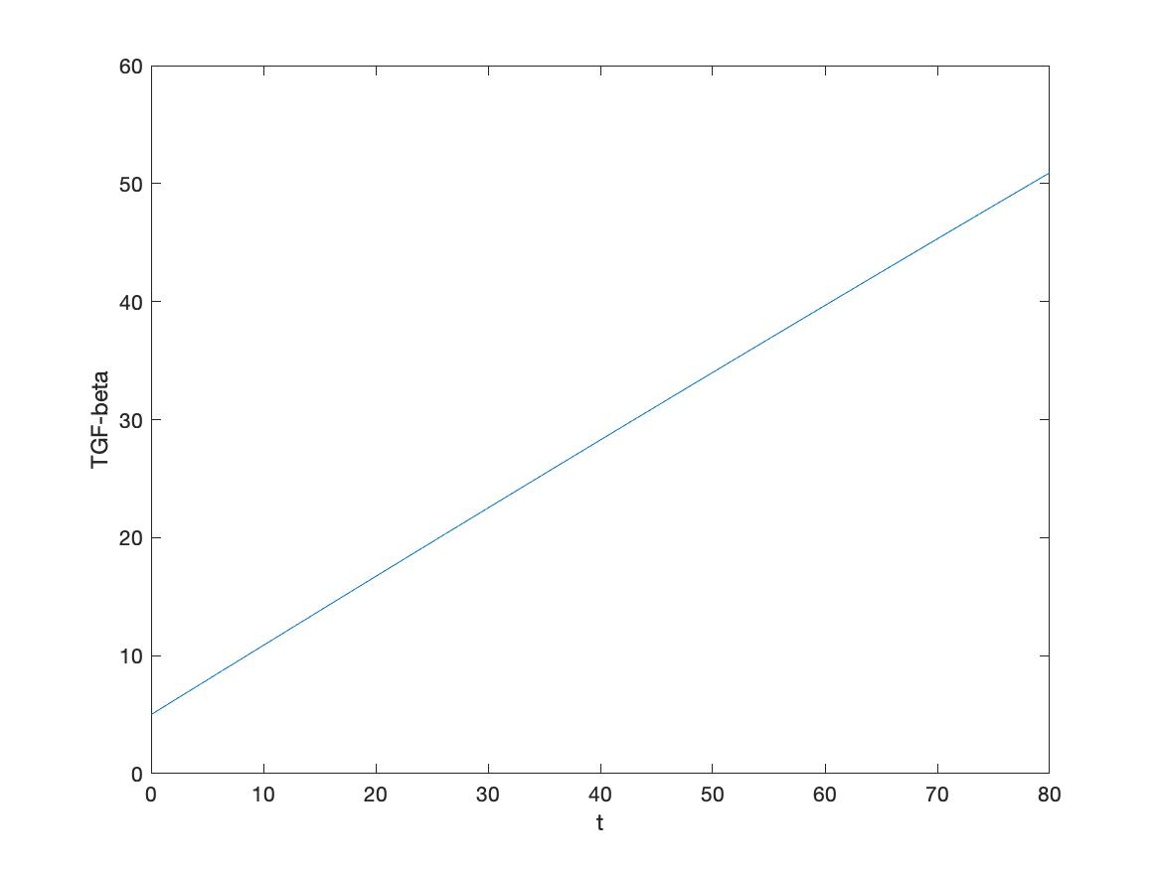
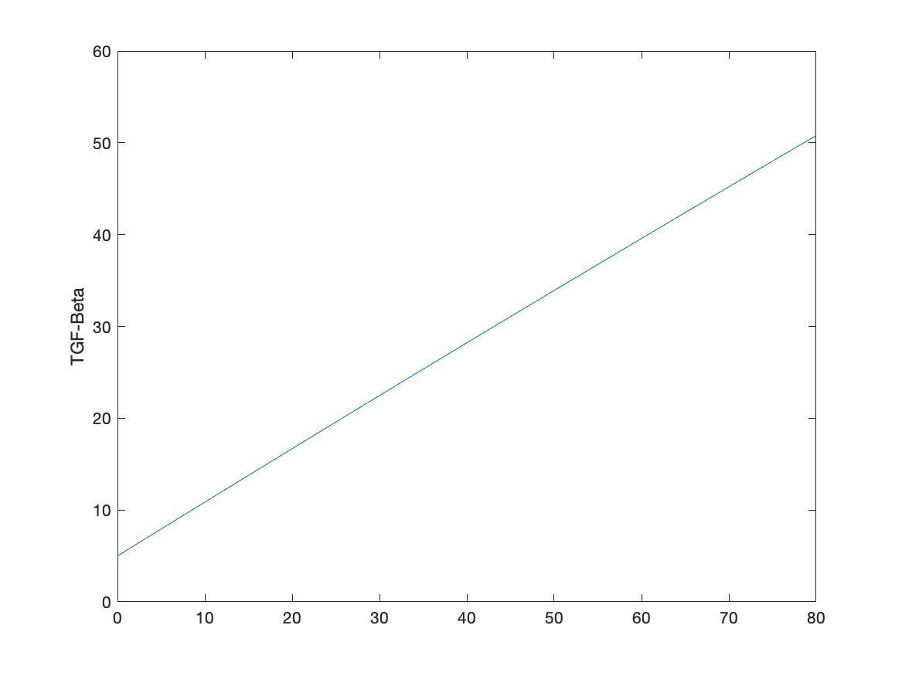
FIGURE 7
Paper
Results

Slide 14
FIGURE 7 (A SIDE): Day 0 and 7 inject 5 x 10^6 M28z CAR-T cells

Slide 15
FIGURE 7 (B SIDE): Day 0 and 7 inject 5 x 10^6 M28z-KTO CAR-T cells

Slide 16
INTERPRETATION OF RESULTS
THE GOAL OF THE PAPER: To determine the mathematical scenarios under which treatment using CAR-T therapy and TGF - β inhibition will allow tumors and cancer cells (stem and non-stem) to be targeted and eliminated.
APPLICATION OF RESULTS DISCUSSED TO THE PAPER’S GOAL:
The ODEs created by the authors simulate tumor and effector cell growth well using the parameters set by the in vitro experiments (Shown in Figures 4 and 5).
This is helpful as it shows that the ODEs generated are good models for mathematical cancer therapy testing.
Compared to figure 3, including therapy that inhibits TGF- β and/ or Car-T cell therapy slows the rapid growth of the stem and tumor cells that could help with treatment in earlier stages.

Slide 17
CREDITS
Swanson, Köse, Zollinger. Mathematical Modeling of Tumor and Cancer Stem Cells treated with CAR-T Therapy and Inhibition of TGF- β.
Zhang BL, Li D, Gong YL, Huang Y, Qin DY, Jiang L, Liang X, Yang X, Gou HF, Wang YS, Wei YQ, Wang W (2019) Preclinical evaluation of chimeric antigen receptor-modified t cells specific to epithelial cell adhesion molecule for treating colorectal cancer. Hum Gene Ther 30(4):402–412. https://doi.org/10. 1089/hum.2018.229
Han Y, Sun B, Cai H, Xuan Y (2021) Simultaneously target of normal and stem cells-like gastric cancer cells via cisplatin and anti-CD133 CAR-T combination therapy. Cancer Immunol Immunother. https:// doi.org/10.1007/s00262-021-02891-x
Tang N, Cheng C, Zhang X, Qiao M, Li N, Mu W, Wei XF, Han W, Wang H (2020) TGF-β inhibition via CRISPR promotes the long-term efficacy of CAR T cells against solid tumors. JCI Insight. https:// doi.org/10.1172/jci.insight.133977
https://github.com/erkara/cancer_immunology (Link to the Github with Matlab code notebooks used to replicate the results of the Swanson paper)

